Slide 1


NASA/SPoRT & NWS WFO
Coordination Call
Kevin Fuell
Geoffrey Stano
19 July, 2012
transitioning unique NASA data and research technologies to operations
Notes:
Always show some examples of LMA, SSTs (show side-by-side with RTG vs SPoRT – Get Jon’s example of sea-breeze), and MODIS (hybrid only) in addition to the overview – Find hot spot location image from Miami – Include a smoke plume image

Slide 2
Agenda
UAHCI product initial input from WFOs at start of evaluation
SPoRT 2nd Annual Virtual workshop: Sept
AMS submissions is August 1
AWIPS II data plugins progress for SPoRT products: HGX testing
WFO plans for AWIPS II: Input as to when switch may occur and possible use of SPoRT plugins
NPP/VIIRS Imagery in SPoRT Hybrid product, and VIIRS Day-Night Band examples

Slide 3
UAH Convective Initiation
Evaluation (July 6 – August 7)
Thank you for your feedback!!
  Both positive and negative feedback are welcome
  At least 12 formal feedback submissions so far
  We are on NWS Chat: “nasa_sport” room
GOES-R PG product
  You are influencing decisions on GOES-R products that may be part of the base suite upon launch
Training has improved product understanding
  Information by UAH found on SPoRT website (http://weather.msfc.nasa.gov/sport/training/)

Slide 4
UAH CI
Caveats:
  very little information about the local atmospheric environment (capping inversion?, shear?)
    Users must apply their local knowledge
  Full disk scans occuring at 0, 3, 6, 9, 12, 15, 18, 21
    These times are skipped.
    Next time is 15 minutes after the hour; therefore, latency is about 30 minutes (i.e. 1745, 1815, 1830 … )
    SoS appears to “jump” to larger values during this 30 minute period – Developers aware and working a solution. Rapid Scan is handled by CI algorithm

Slide 5
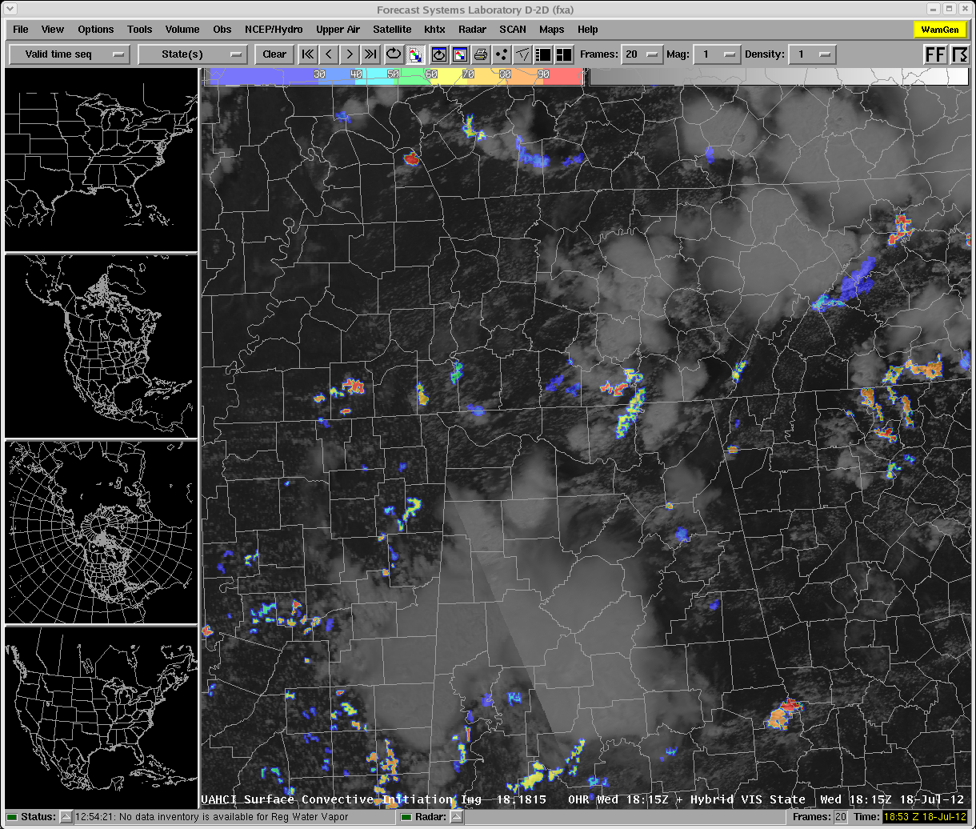
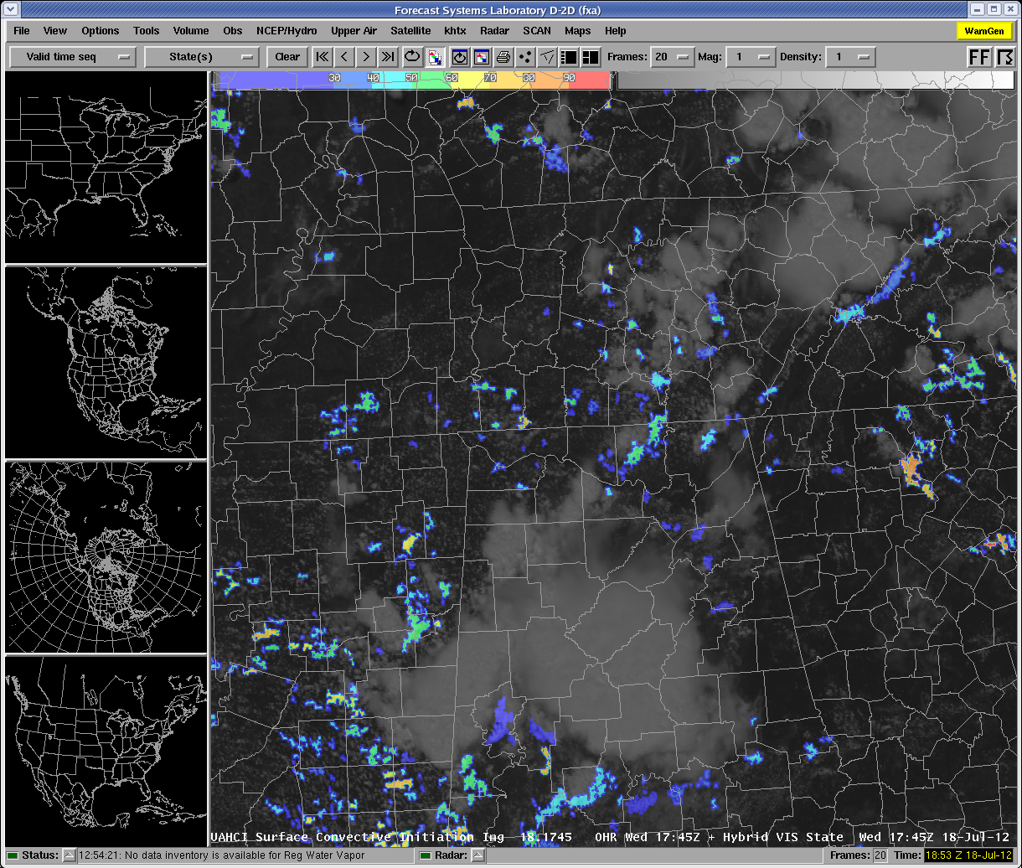
“Jump” in SoS at Full Disk times

Slide 6
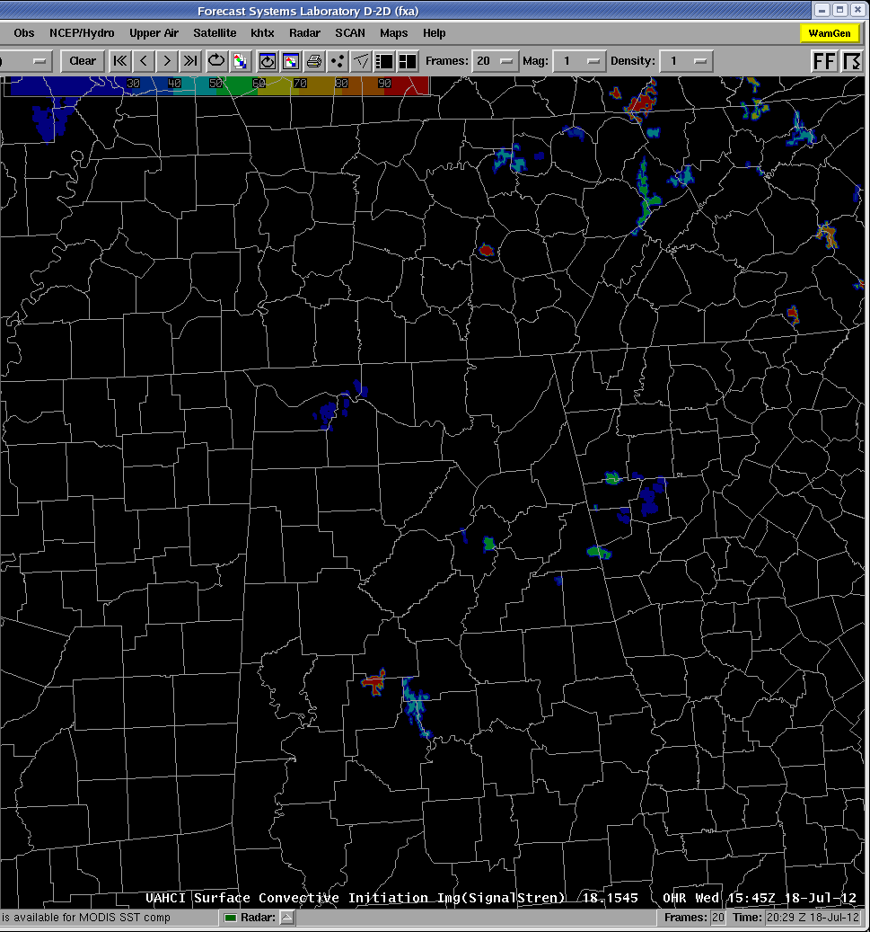
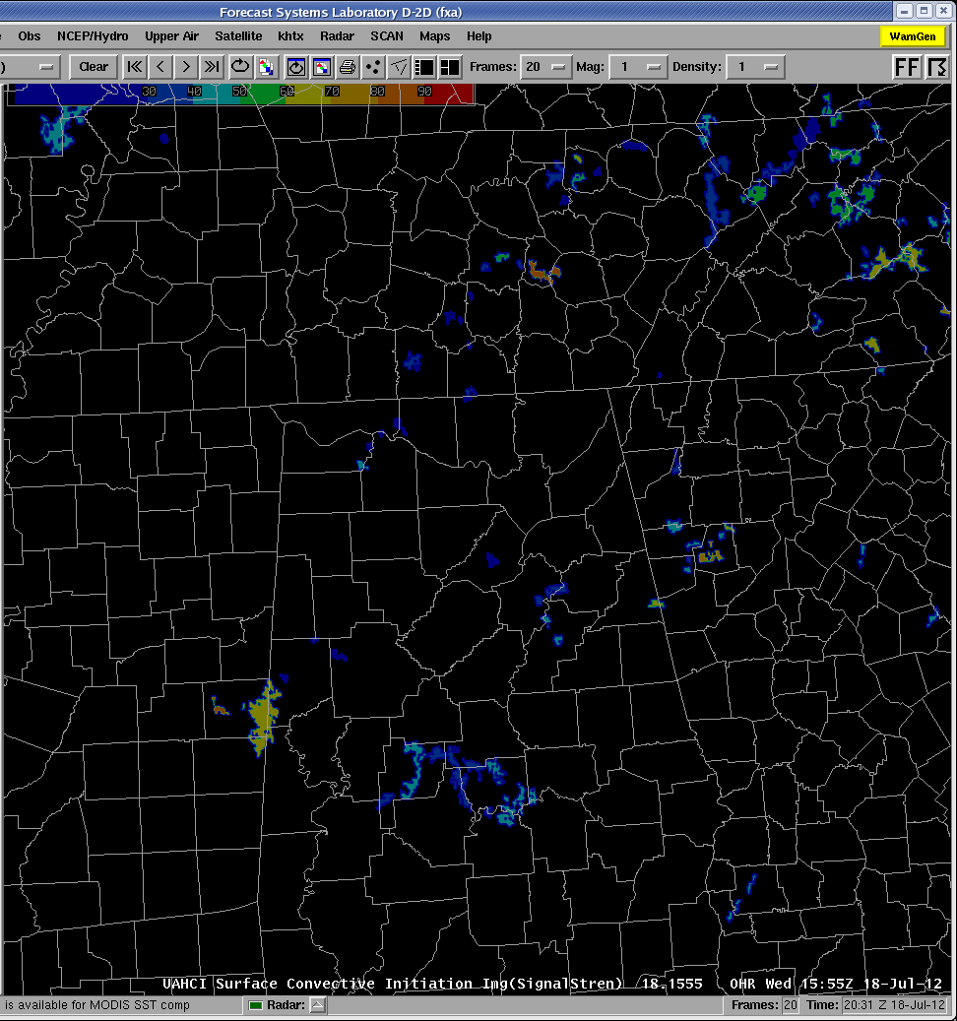
UAH CI, July 18
Valid / Received
1545 / 1600
1555 / 1610

Slide 7
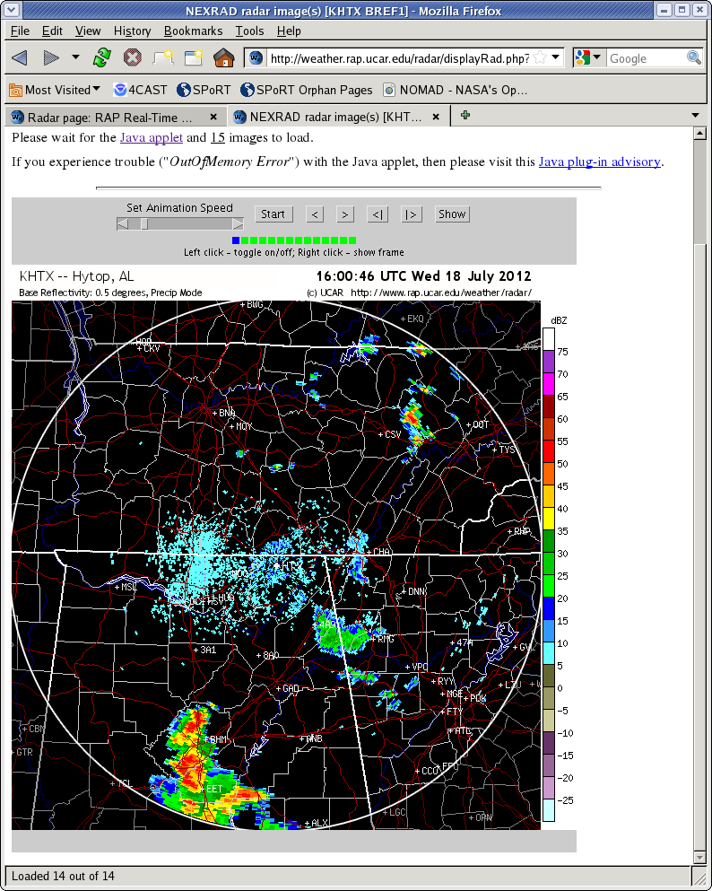
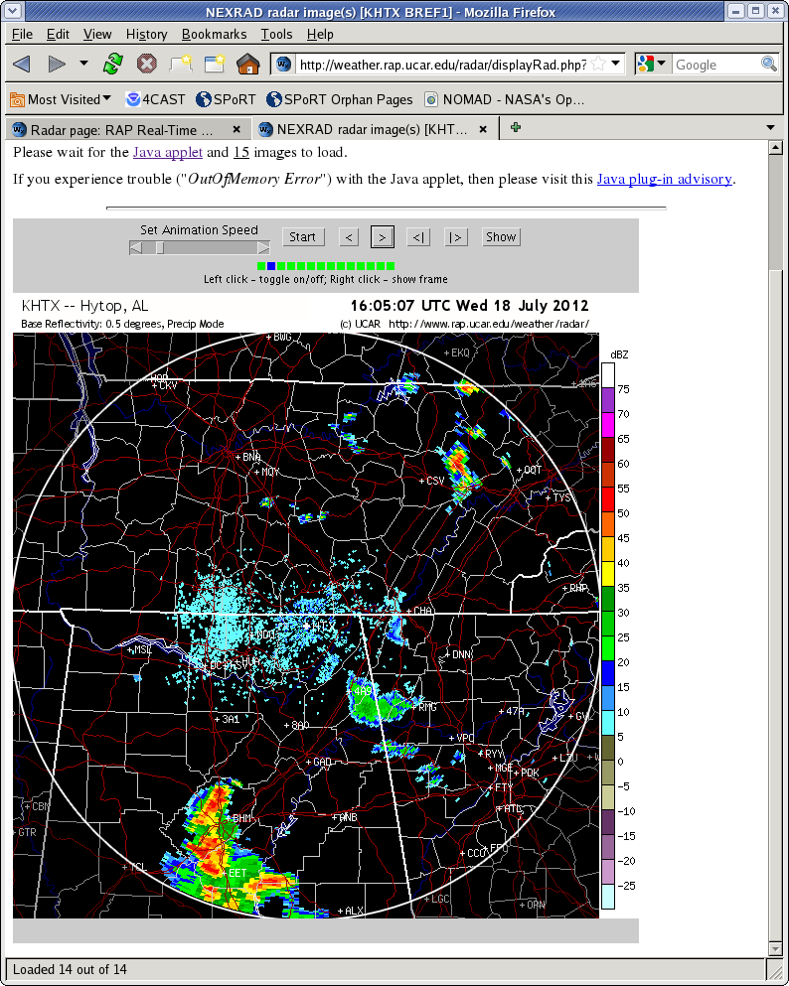
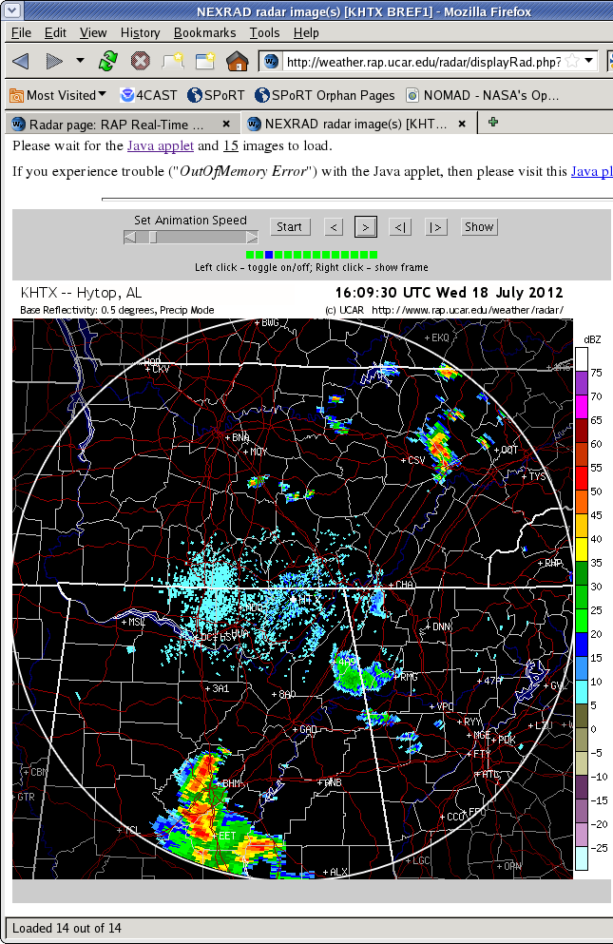
UAH CI, July 18
Valid / Received
1600 \ 1604
1604 \ 1608
1609 \ 1613

Slide 8
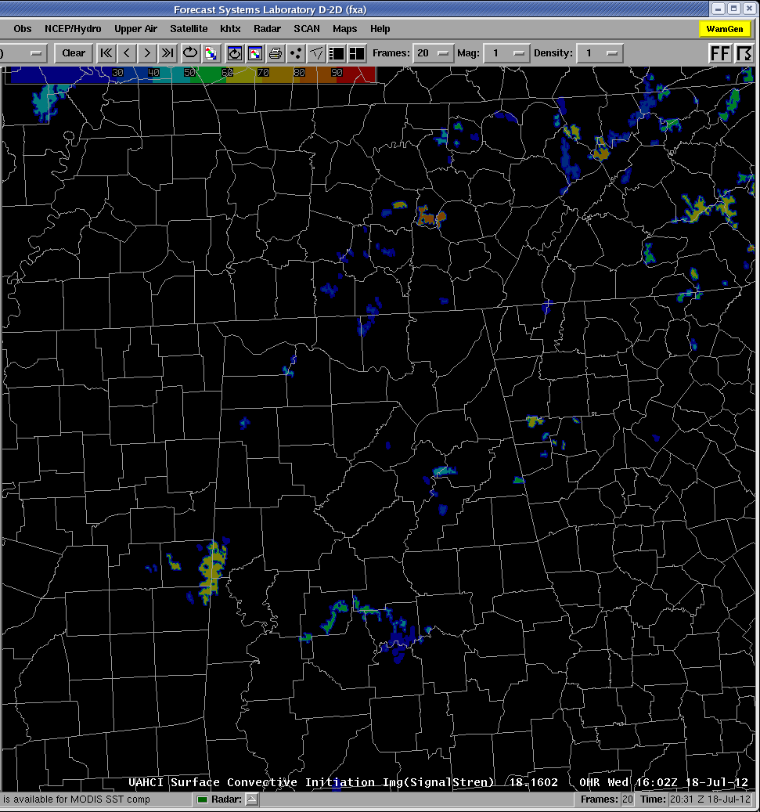
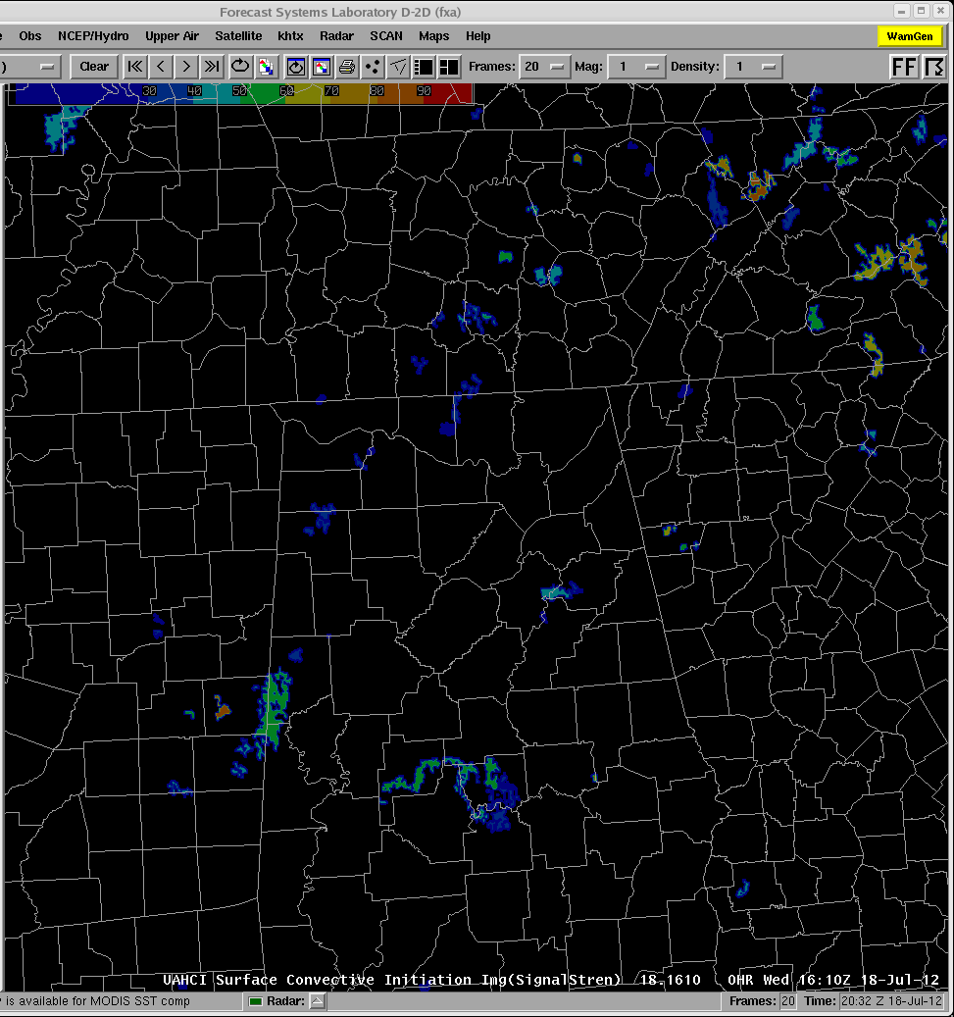
UAH CI, July 18
Valid / Received
1602 \ 1615
1610 \ 1625

Slide 9
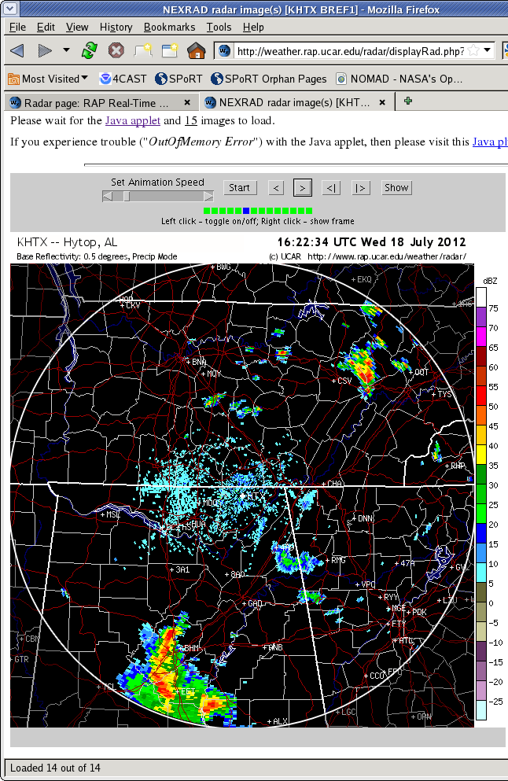
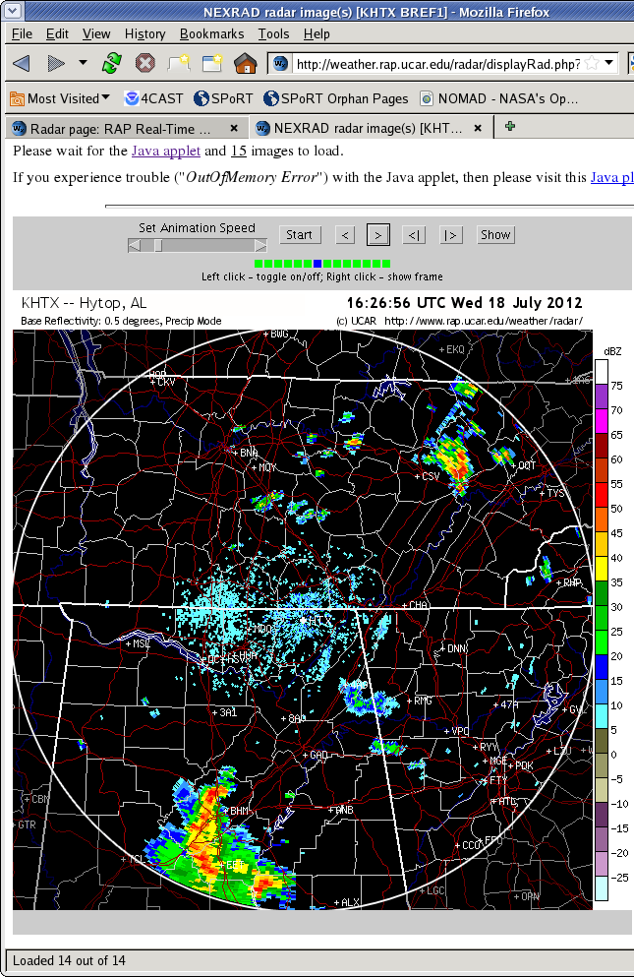
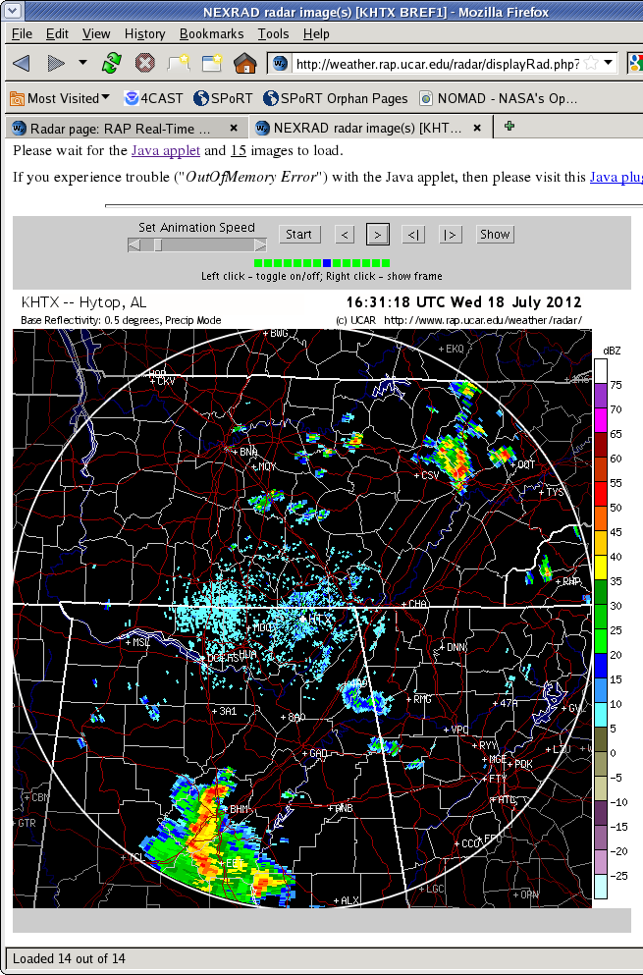
UAH CI, July 18
Valid / Received
1622 \ 1626
1626 \ 1630
1631 \ 1635

Slide 10
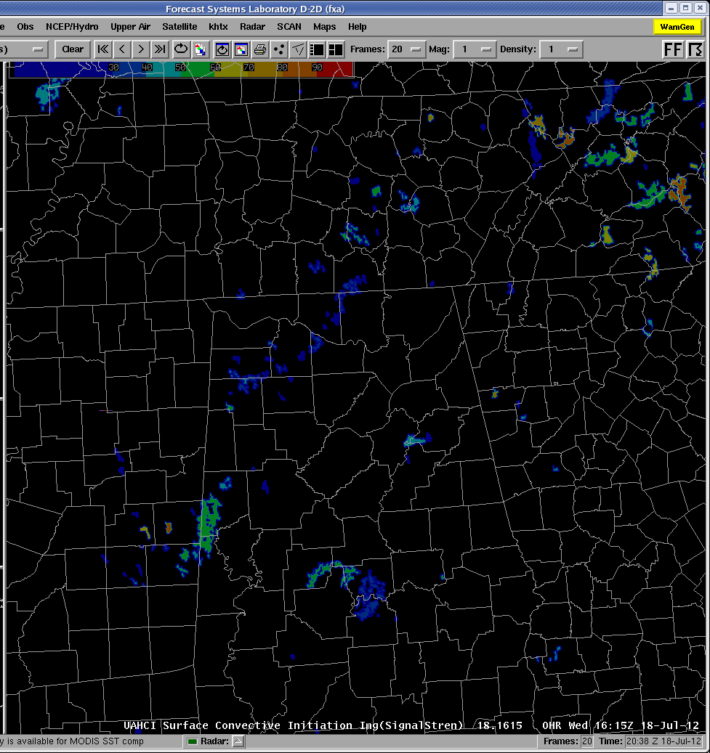
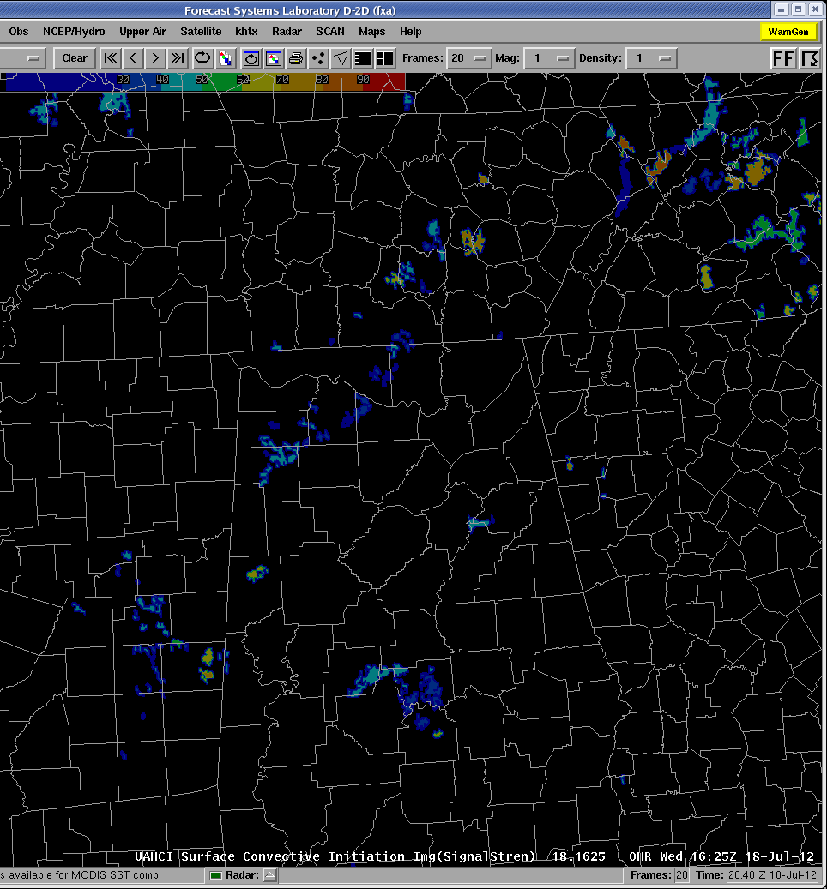
UAH CI, July 18
Valid / Received
1615 \ 1630
1625 \ 1640

Slide 11
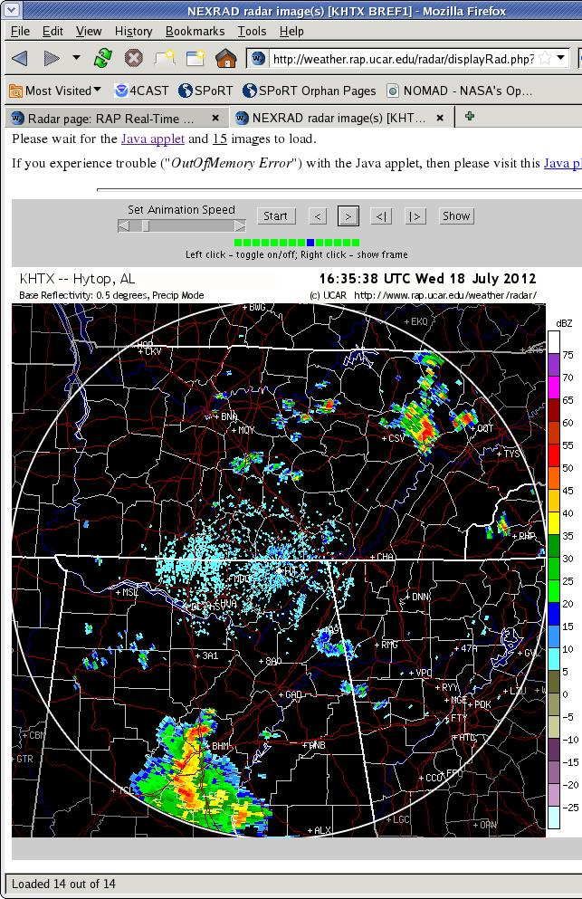
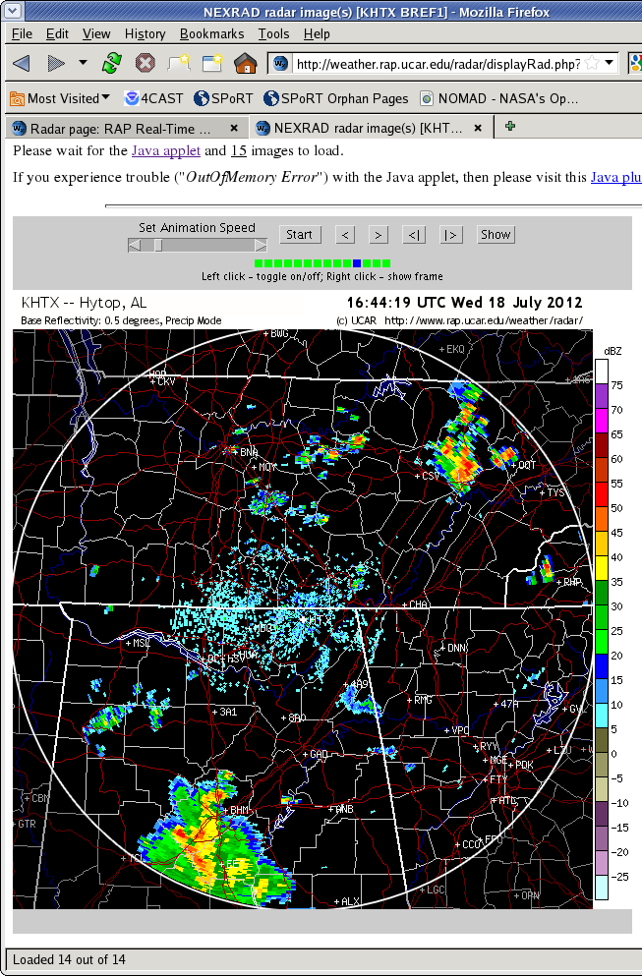
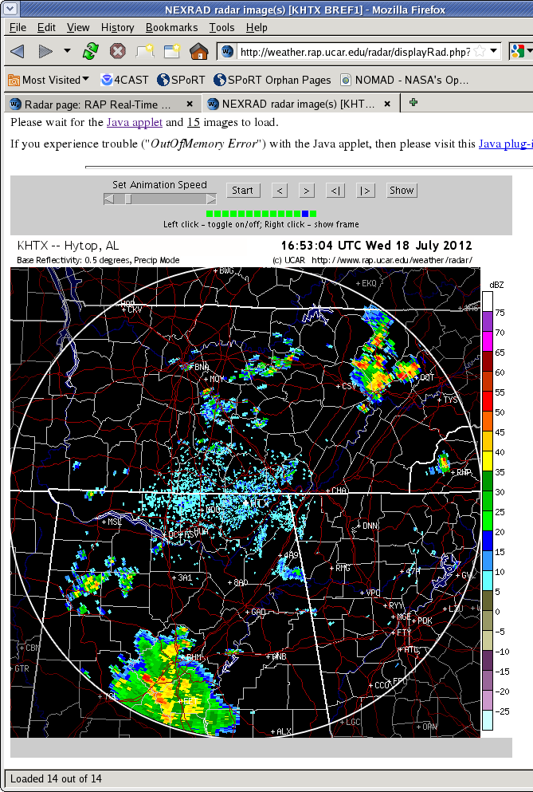
UAH CI, July 18
Valid / Received
1635 \ 1639
1644 \ 1649
1653 \ 1657

Slide 12
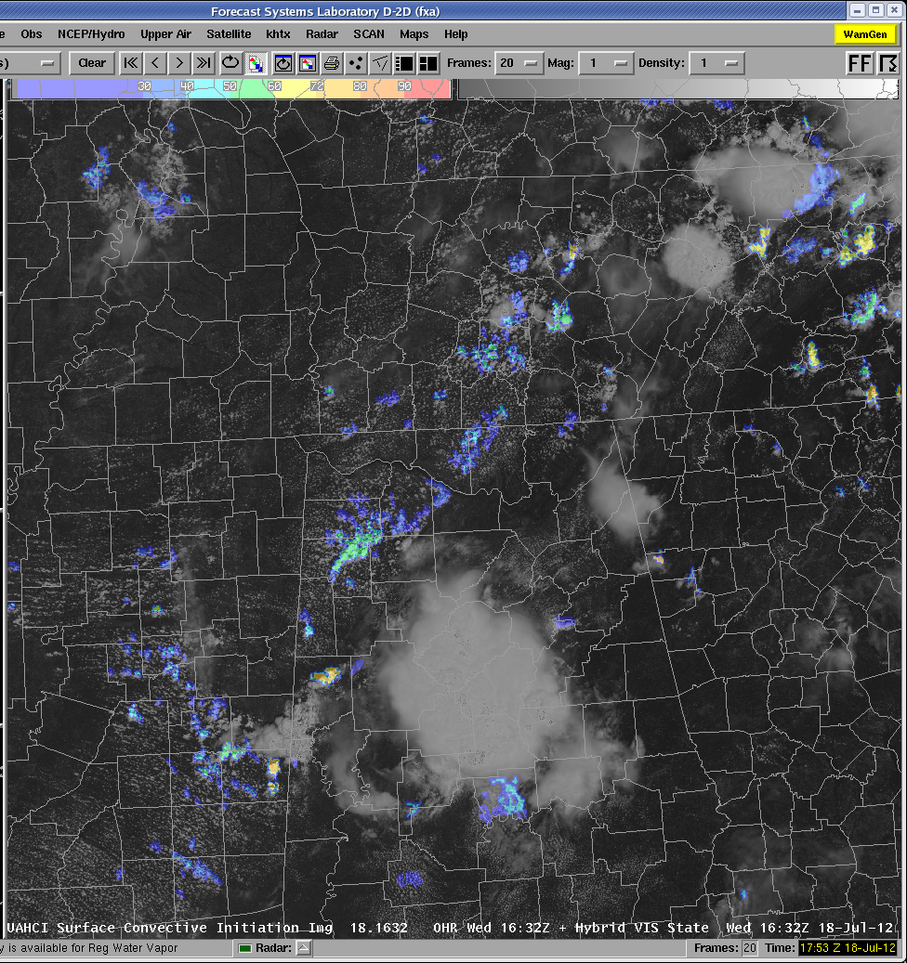

UAH CI, July 18
Valid / Received
1632 \ 1645
1657 \ 1701

Slide 13
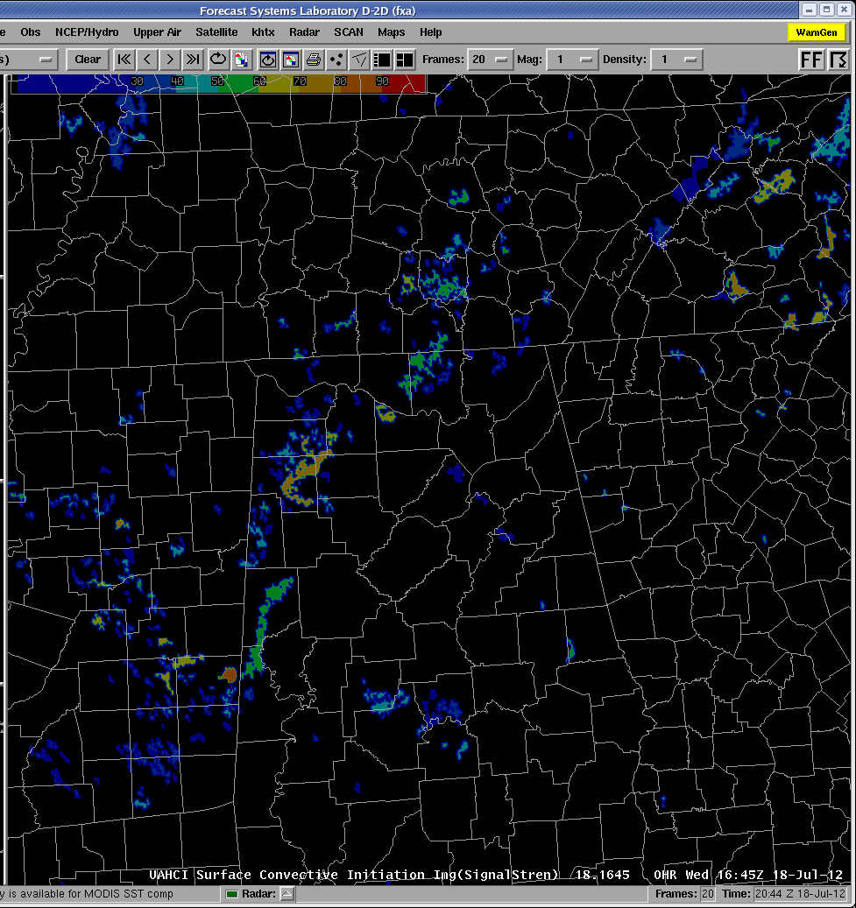
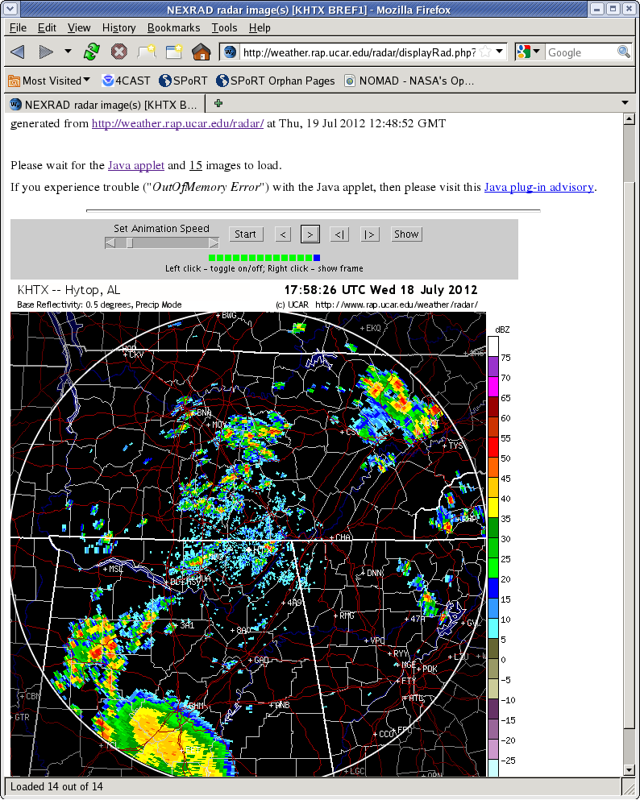
UAH CI, July 18
Valid / Received
1645 \ 1700
1758 \ 1802
Reflectivity area increased in size and intensity during period from 1700-1800 Z; below is end of this period

Slide 14
Initial Feedback
The Positives (so far)
The Negatives (so far)
10-15 minute lead times
Occasional event with a 30 minute lead time
Little lead time in some regimes
High number of misses in some cases
Impact generally small
Slow to load in display if looking at large area and many frames

Slide 15
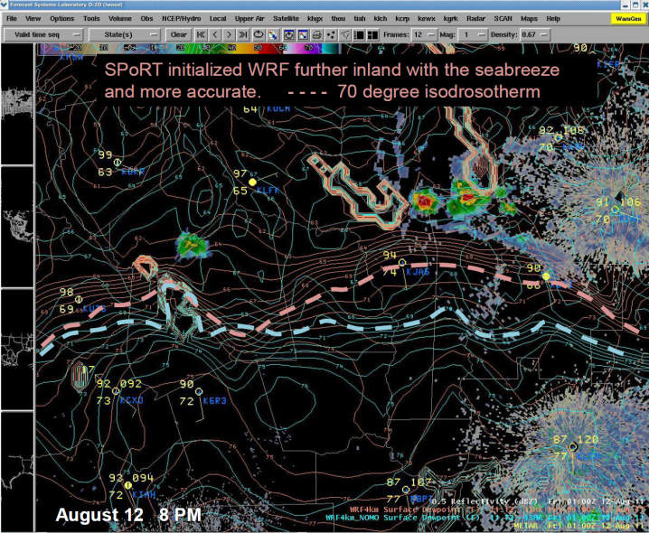
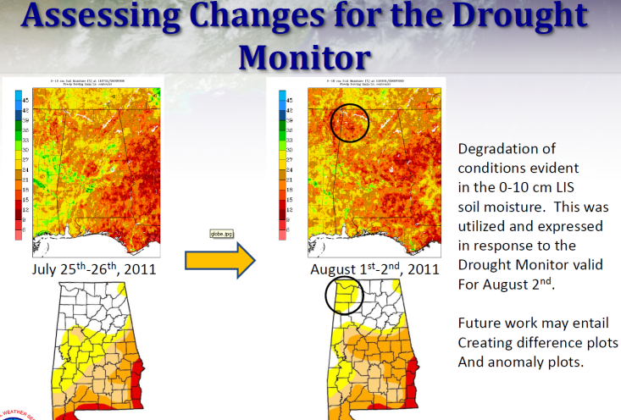
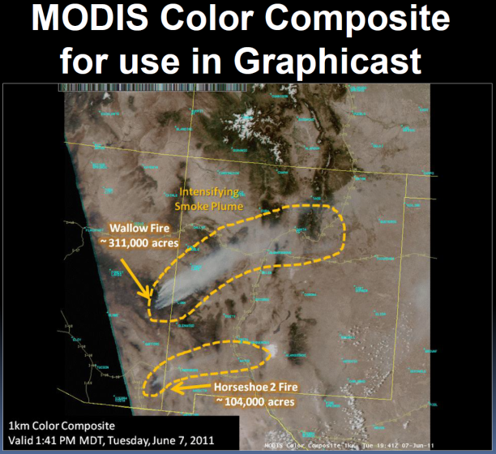
2012 SPoRT Partners Virtual Workshop
Date set for 12-13 September
  Two half-day sessions
General Topics
  Use of MODIS, AIRS, and other SPoRT observational imagery
  Use of total lightning
  Local modeling with SPoRT data
  JPSS and GOES-R Proving Ground
Important Dates
  Abstracts Due – July 27
  Notification of Acceptance – August 3
  Preliminary Agenda – August 24
  Final Agenda – August 31

Slide 16

AMS Annual Meeting Abstracts
Abstracts due August 1
  Need to clear with Bernard first
Opportunity to discuss collaborations

Slide 17
SPoRT AWIPS II Plans
Plugins ready to handle most SPoRT data
  Satellite and Derived (mcidas)
  Total Lightning (lma)
  Convective Initiation (uahci)
  New products/tools
    HMS Smoke
    HMS Hotspot
    WindSat
    Tracking tool
Other SPoRT products (GRIB2) will work w/ A2
  Testing still ongoing: Started at HGX (M. Keehn input)
We will test when you’re comfortable w/ A2
  What are anticipated A2 switch dates?

Slide 18
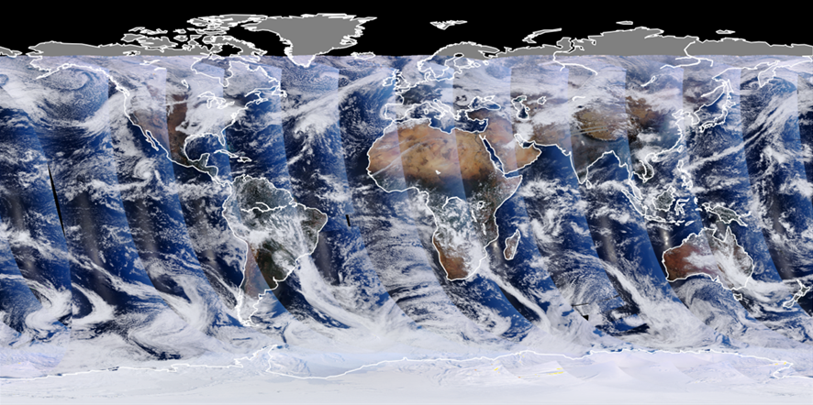
Transitioning NPP / VIIRS Observations
VIIRS aboard Soumi NPP
Key Features
  Continues many capabilities of MODIS
  Precursor to GOES-R ABI instrument
  Superior data swath and limb resolution
  New channels: Day-Night Band
Status
  Now have data access
  Preparing initial products
Identifying evaluators
VIIRS global true color composite. Note no gaps
between passes as would be seen in MODIS.
Each swath ~3000 km wide.

Slide 19
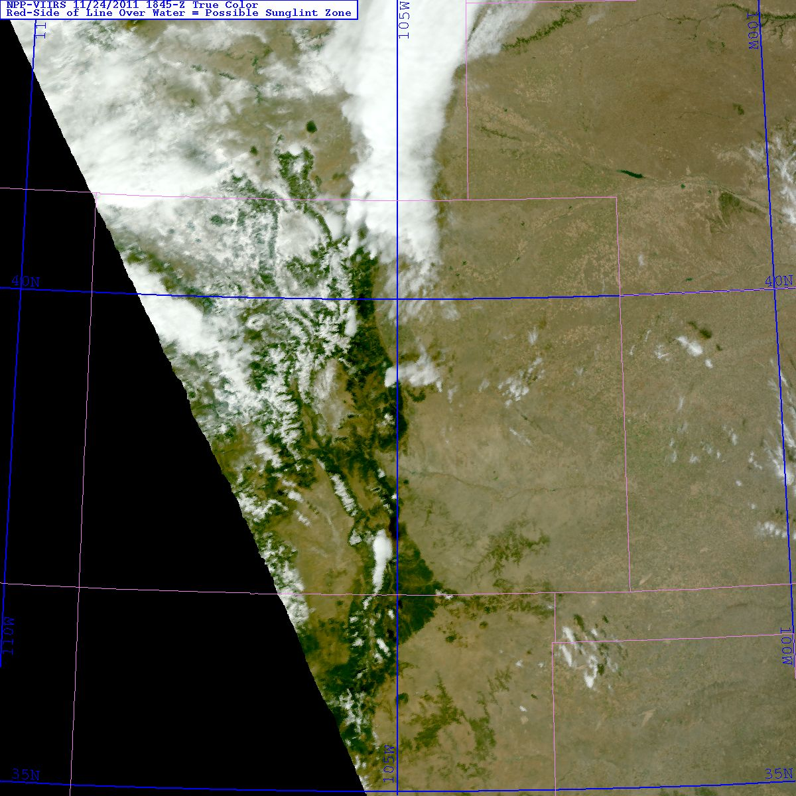
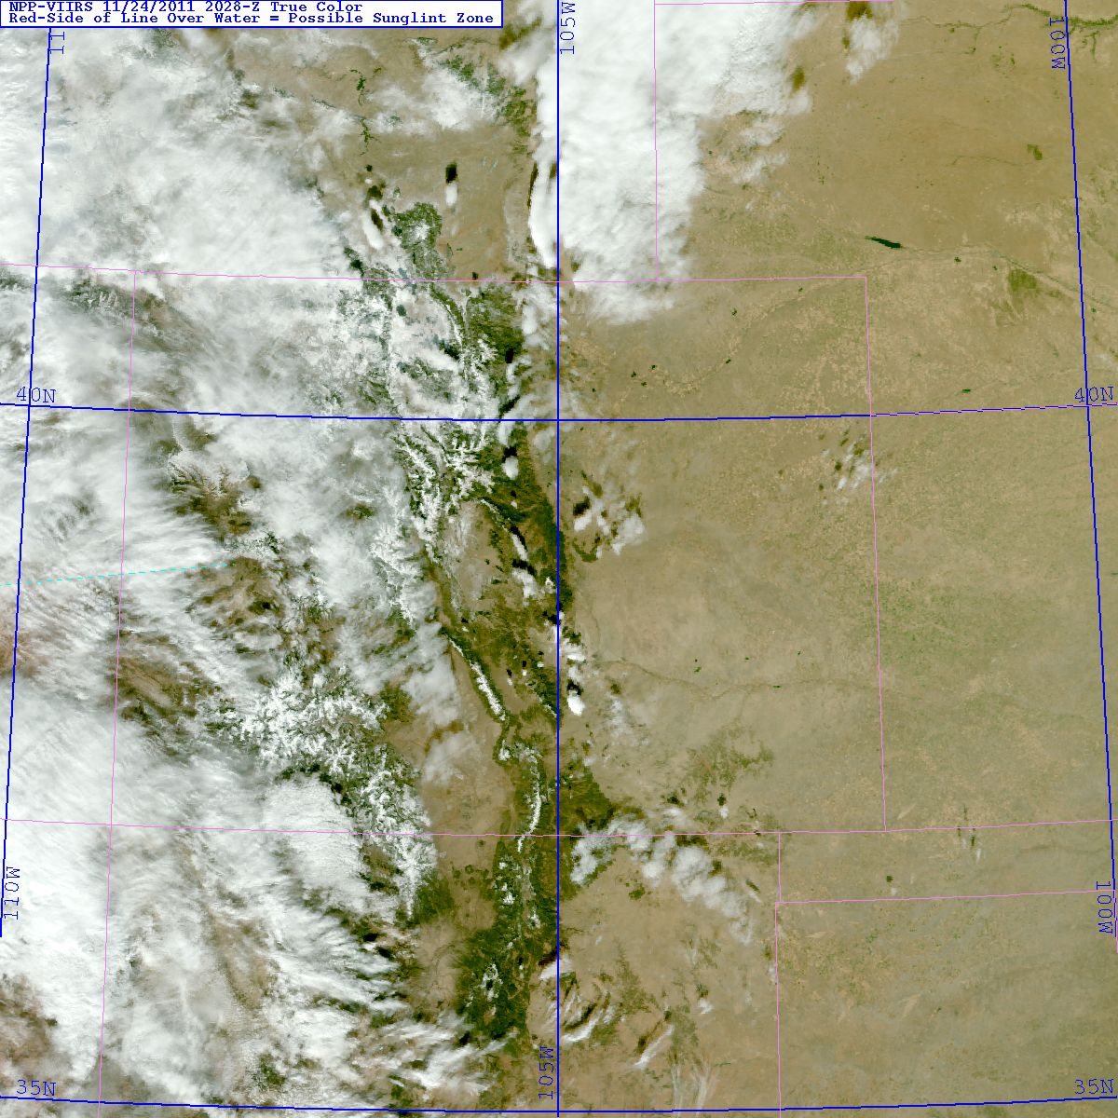
Unique VIIRS Features
VIIRS maintains spatial resolution at edge of swath.
Near edge 1845 UTC
Near nadir 2028 UTC

Slide 20
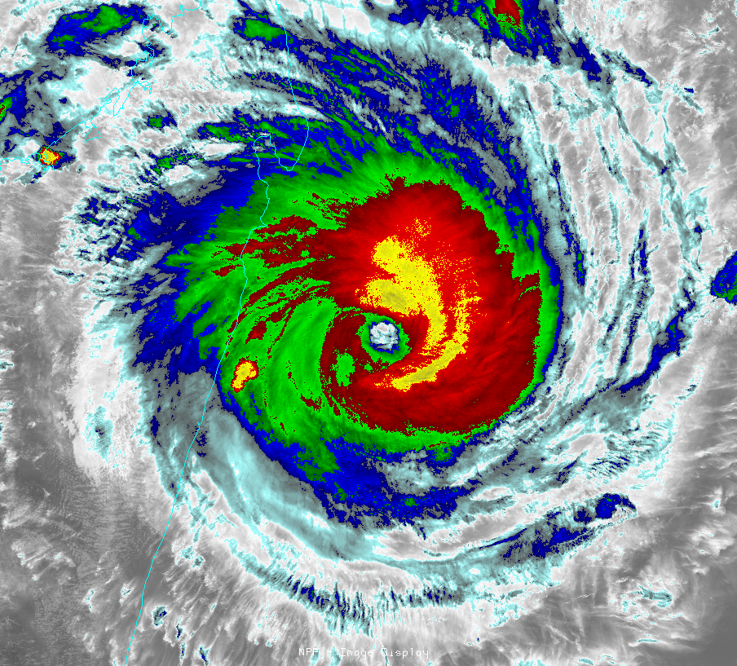
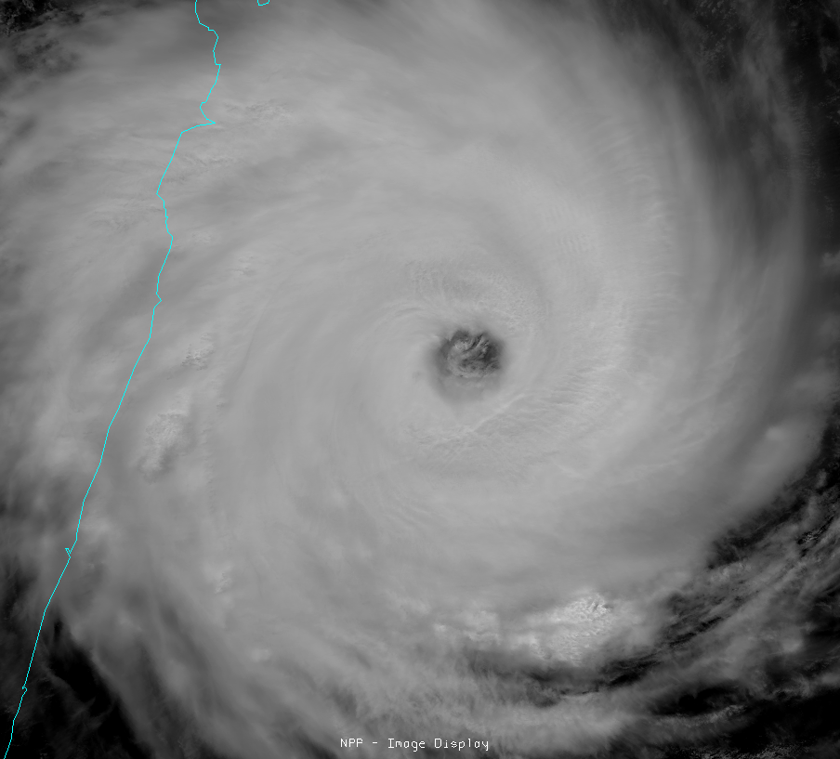
High Spatial Resolution
Tropical Cyclone Giovanna east of Madagascar
13 February 2012 at 0947 UTC
VIIRS channel I-5 (IR window, 11.45 µm)
VIIRS channel I-1 (visible, 0.64 µm )
Courtesy: D. Lindsey (NOAA/STAR/RAMMB)

Slide 21
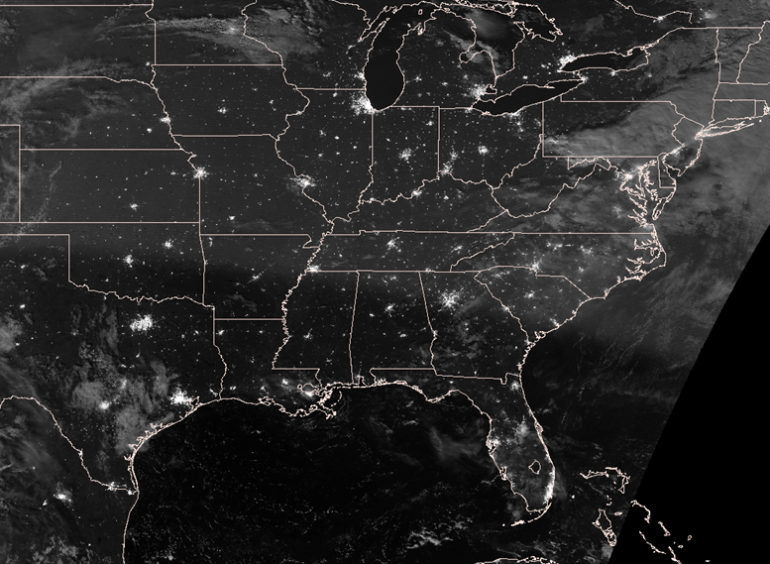
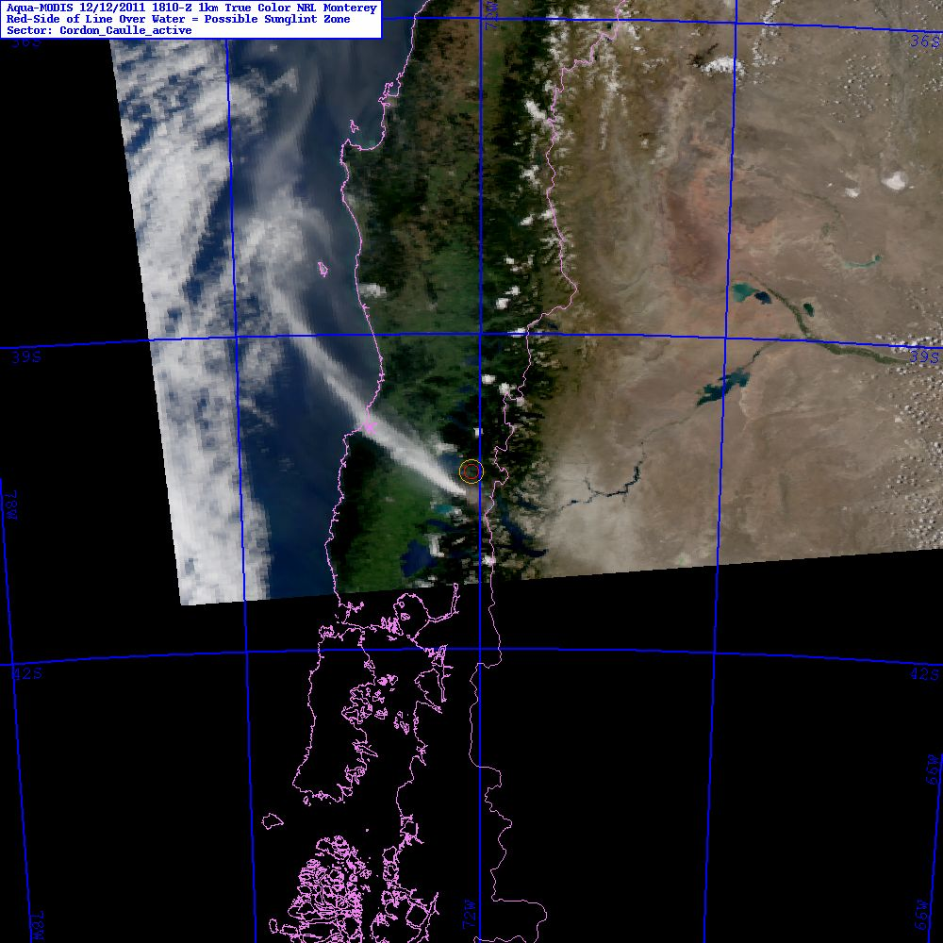
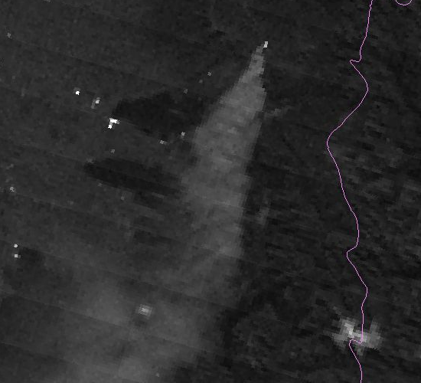
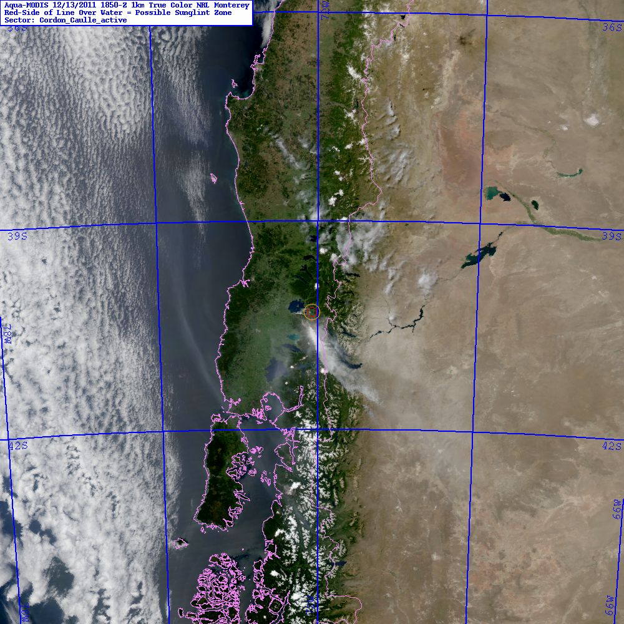
VIIRS Day-Night Band
Afternoon
Night
Morning
Nighttime pass fills in the temporal gap between last PM and first available AM visible-light observations.
Courtesy: CIRA and NRL

Slide 22
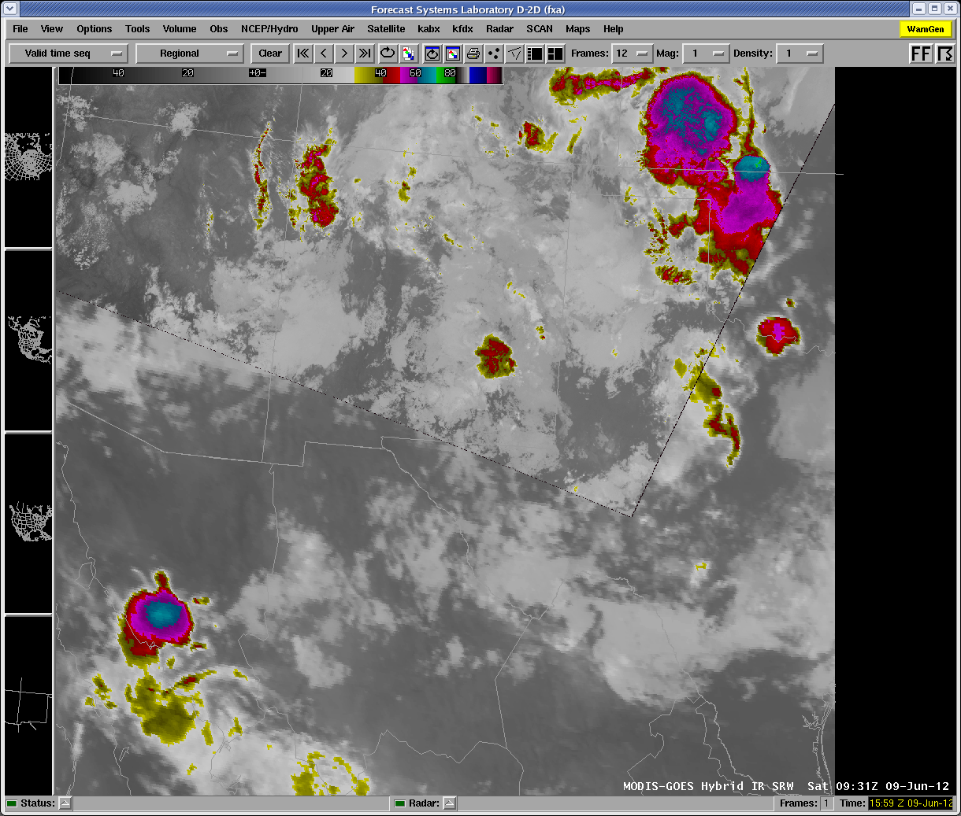
Transitioning NPP / VIIRS Observations
Start with Basics
  Hybrid
  Using MODIS and VIIRS in same product
  Single swaths (like day-night band)
Further Actions
  Incorporate VIIRS in RGB products
VIIRS
GOES

